Slide 1
JOINS AND
DATA BLENDING

Slide 2
AGENDA
Introduction
Data Combining Introduction
Joins in SQL
Types of Joins
Drawbacks of Joins
Introduction to Data Blending
Objective of Data Blending
Joining vs Blending
Blending Data in Tableau
Limitations of Data Blending

Slide 3
INTRODUCTION
SQL : ANSI standard language for all Relational Database Management Systems (RDBMS)
Backbone of all Databases like Oracle, Sybase, DB2, MS SQL, MySQL etc.
RDBMS stores data in the form of “Tables”, specifically called Relations.
Data Retrieval Methods:
  Single Table Retrieval:
      Selection : With condition Data Retrieval (SELECT * FROM <TN> WHERE <CONDITION>)
      Projection : Without condition Data Retrieval (SELECT * FROM <TN>)
  Multi-table retrieval:
      Joins : Retrieve data from multiple tables

Slide 4
DATA COMBINING INTRODUCTION
It is often necessary to combine data from multiple places to perform a desired analysis. Data might not be present in a single data table, but rather, spread across multiple tables.
Depending on the structure of the data and the needs of the analysis there are several ways to combine the tables
Ways to combine data:
      Relationships
      Joins
      Union
      Data Blending
Combining data between two or more tables or sheets within the same Data Source is Data Joining
Combining data from two or more different sources is Data Blending

Slide 5
JOINS IN SQL
A Join is a means for combining fields from two tables by using values common to each table.
The SQL Joins clause is used to combine records from two or more tables in a database.

Slide 6
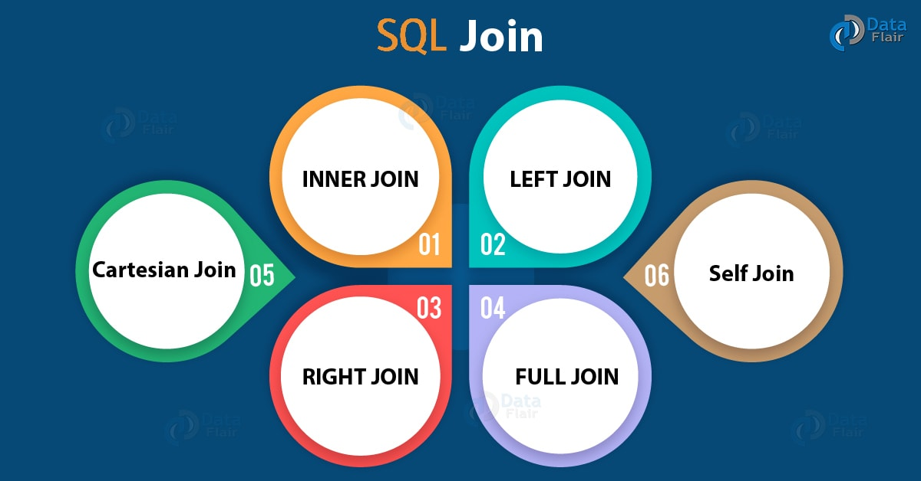
TYPES OF JOINS
ANSI format joins:
      Inner Join
      Outer Join
          Left Outer Join
          Right Outer Join
          Full Outer Join
      Cross Join /Natural Join

Slide 7
TYPES OF JOINS (CONT’D)
Non-ANSI format joins:
      Equi Join
      Non Equi Join
      Self Join

Slide 8
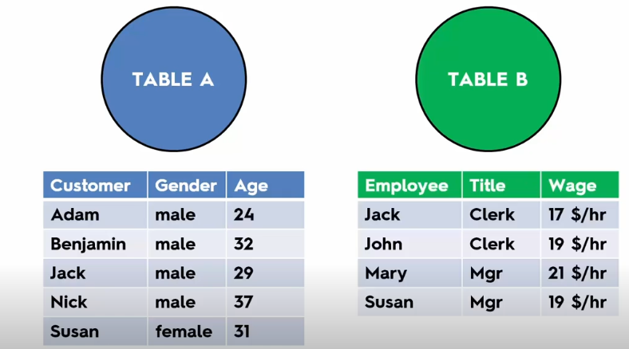
INNER JOIN

Slide 9
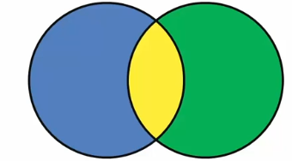
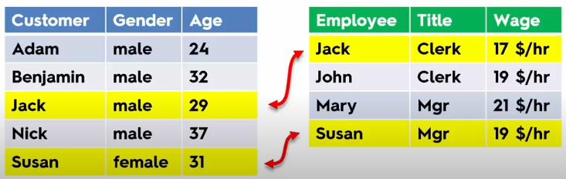
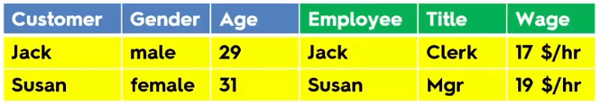
INNER JOIN on : A.customer=B.Employee

Slide 10
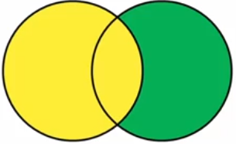
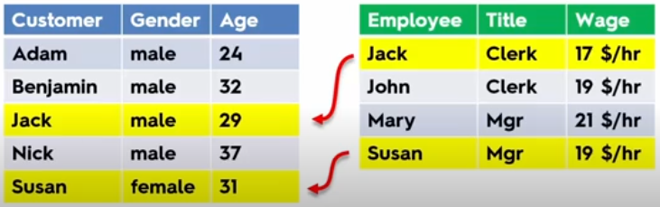
LEFT OUTER JOIN
ON: A.Customer=B.Employee

Slide 11
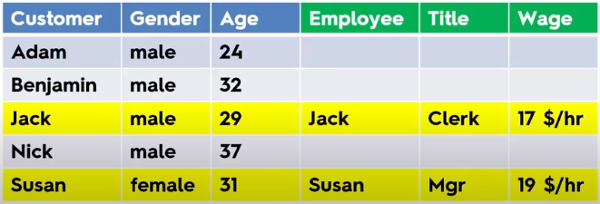

Slide 12
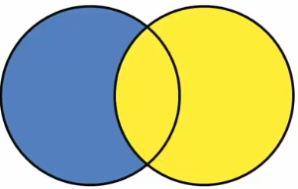
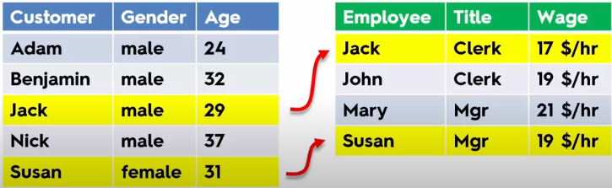
RIGHT OUTER JOIN
ON: A.Customer=B.Employee

Slide 13
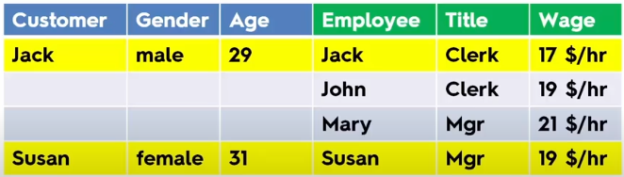

Slide 14
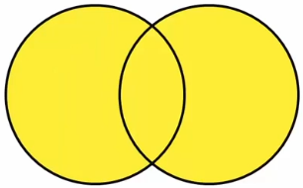
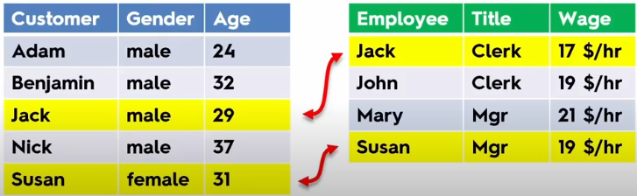
FULL OUTER JOIN
ON: A.Customer=B.Employee

Slide 15
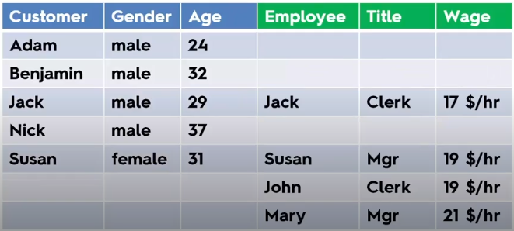

Slide 16
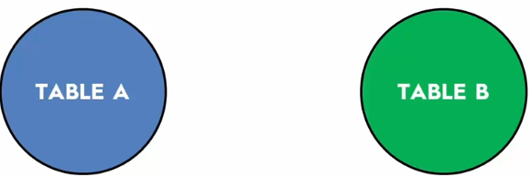
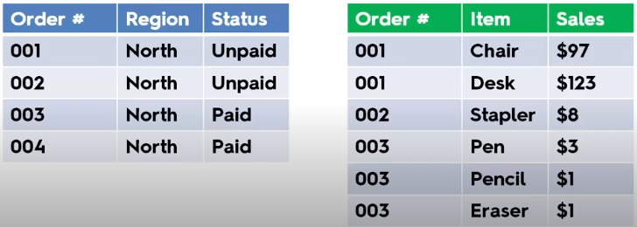
DUPLICATES IN JOIN

Slide 17
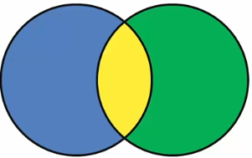
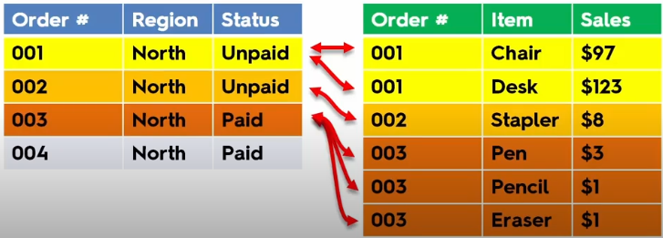
INNER JOIN
ON: A.orderNo=B.orderNo

Slide 18
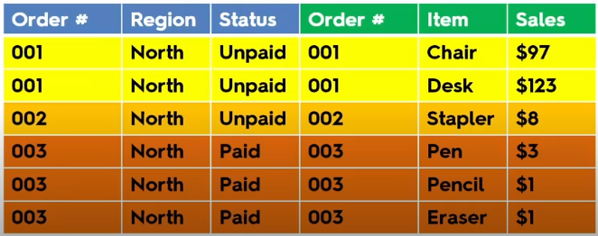

Slide 19
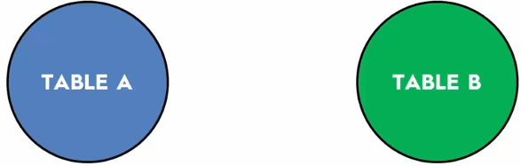
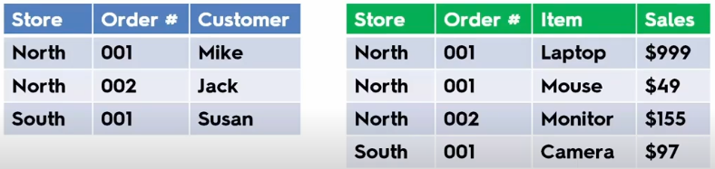
JOINING ON MULTIPLE FIELDS

Slide 20
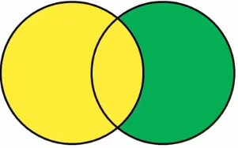
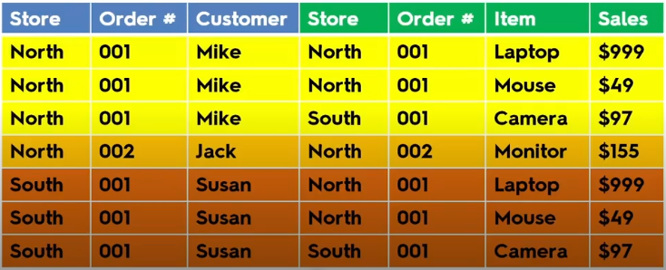
LEFT JOIN
ON: A.orderno=B.orderno

Slide 21
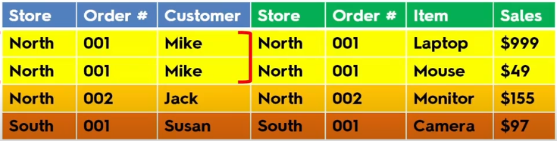
LEFT JOIN
ON: A.orderno=B.orderno AND A.store=B.store

Slide 22
DRAWBACKS OF JOINS
Duplicate records
Increased number of records
Performance issue

Slide 23
INTRODUCTION TO DATA BLENDING
Data blending is a method for combining data that supplements a table of data from one data source with columns of data from another data source.
Advanced version of left join.

Slide 24
OBJECTIVE OF DATA BLENDING
When to use Data blending?
Want to combine data from different databases that are not supported by cross-database joins
Data is at different levels of details (Granularity)
Dealing with large amounts of data
Data needs some cleaning

Slide 25
JOIN VS BLEND
NO | DATA JOINING | DATA BLENDING
1. | Used when the data set is from the same source | Used when the dataset is from a different data source
2. | Ability to use different types of join (left join, right join, inner join and full outer join) | Uses only left join.
3. | Data has to be maintained at the same level of granularity | Data can be available in different level of granularity.
4. | Joins data at a row-level | Sends separate query to each dataset, aggregates and then performs blending

Slide 26
JOIN VS BLEND (CONT’D)
BLEND is like a smart left join on the fly
Common fields with same name are picked up automatically as the blend clause
Blending occurs at the granularity of your view
Aggregation happens before the blend
Blends are unique to each worksheet

Slide 27
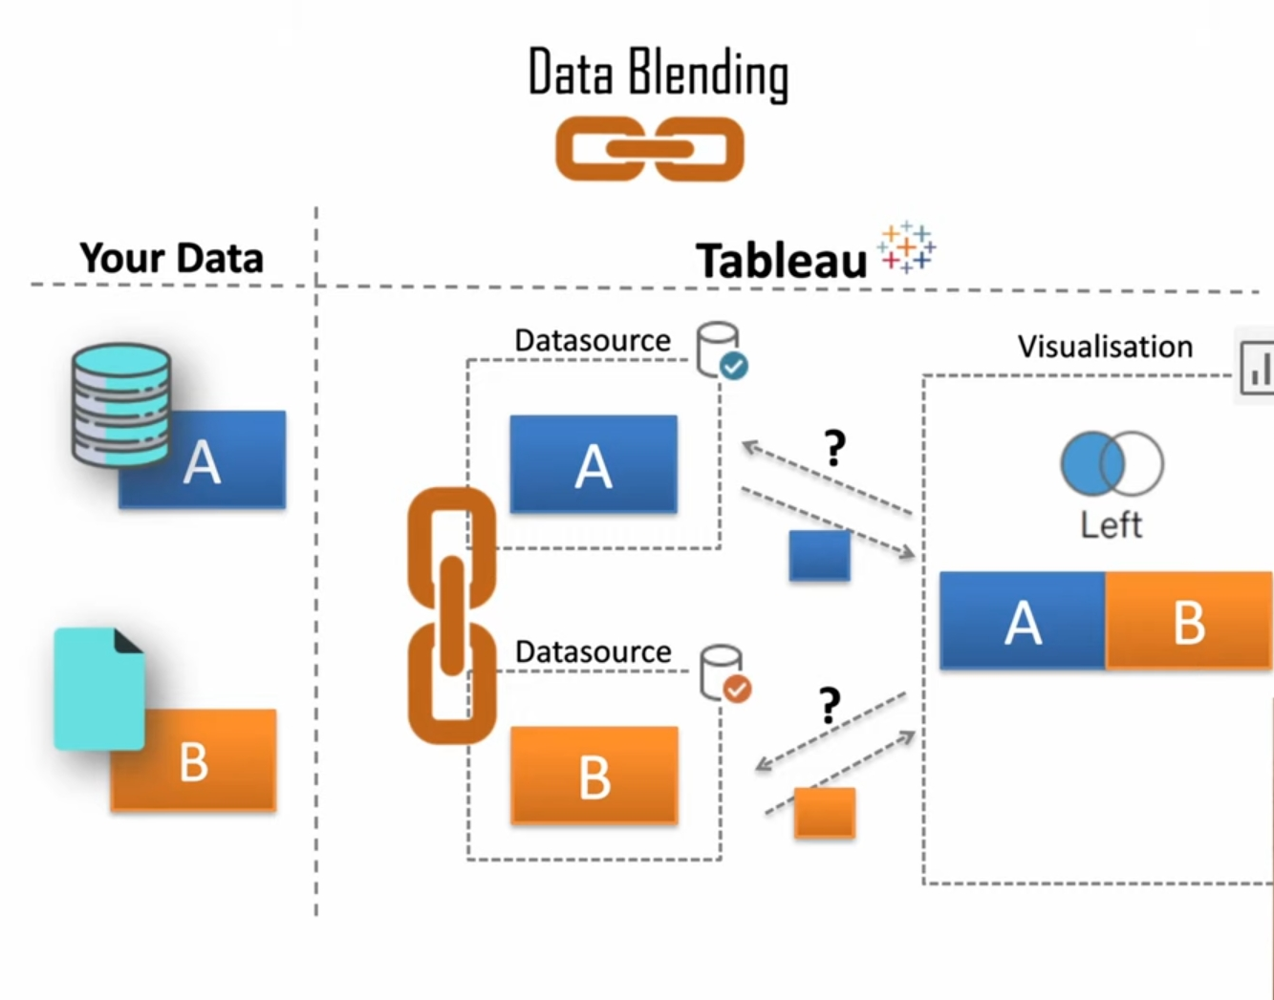
DATA BLENDING

Slide 28
LIMITATIONS OF DATA BLENDING
Blending with Non-Additive Aggregates
Compromises the speed of query in high Granularity
Null values appear after blending data sources
Sort is not available

Slide 29
CONCLUSION
Using Data Blending technique, data coming from numerous data sources is combined into a single view.
Using Data Blending feature in Tableau, we can directly display information in the view by combining different data sources.
Tableau’s Data Blending feature helps connect and source data from multiple data sources and provides relationships, combines data, generates reports easily.
This allows businesses to avoid using third party tools and applications to connect and source data from various enterprise systems. This saves effort and time for businesses.
The blending feature allows businesses to gain deeper intelligence information from enterprise data.

Slide 30
Thank You
Questions?

